Slide 1


SAP UI5 & FIORI with OData TRAINING
Anubhav Oberoy
Day – 18

Slide 2

Agenda – Day 18
Basics of Connectivity
Steps to Setup the Cloud Connection.
Creating the destination in the BAS
Connecting with cloud connector in BTP
Integrating our Fiori App with the Odata service in BAS
Configuring ui5.yaml file to use oData service in VS Code
Implementing the Get Entity Set in UI

Slide 3

Basics of Connectivity and Role of SCC
Internet
Local PC
Intranet
VPN
SAP BW
SAP ECC
SAP S/4 Hana
SAP BTP (PublicCloud)
SAP Cloud Connector
SAP On-premise System
SAP Business Application Studio
SCC
Destination
S/4 Hana Cloud
Field Glass
Sales Force

Slide 4
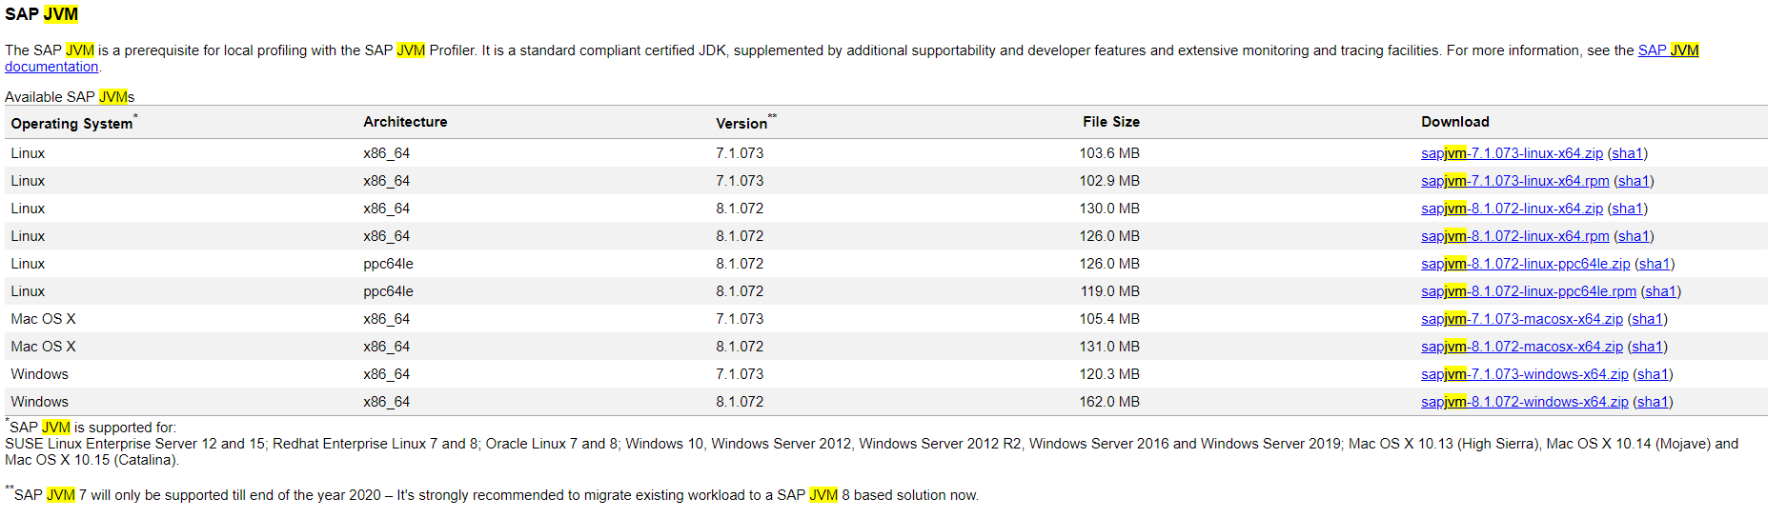
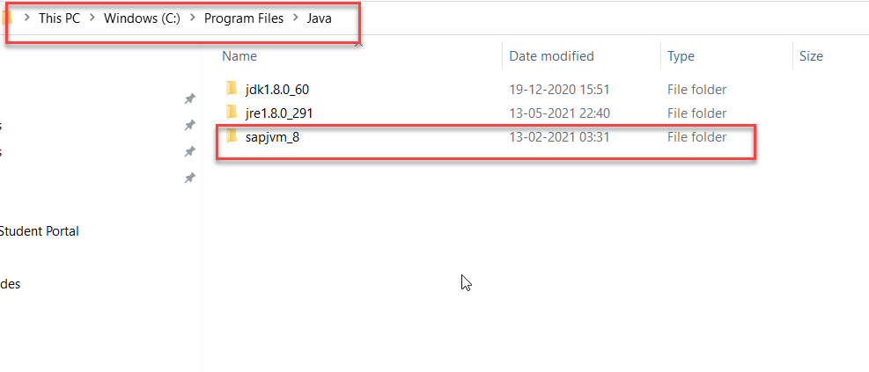
Cloud Connector
Step 1: Download SAP JVM and Extract it in the C:\Program Files\Java

Slide 5
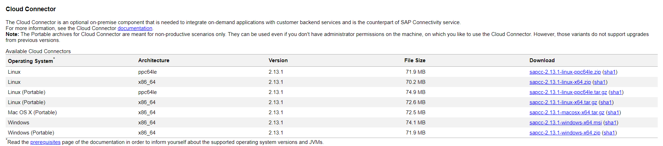
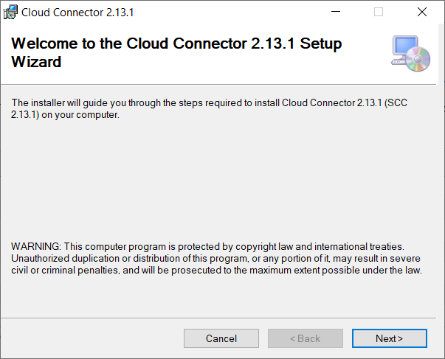
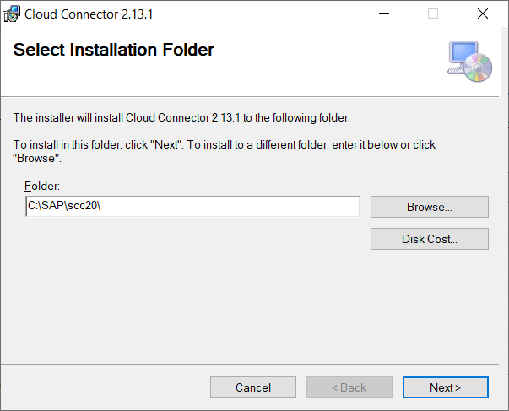
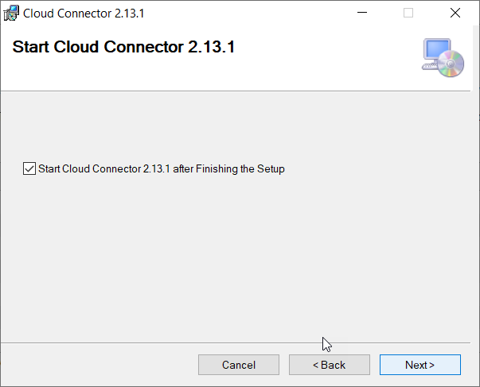
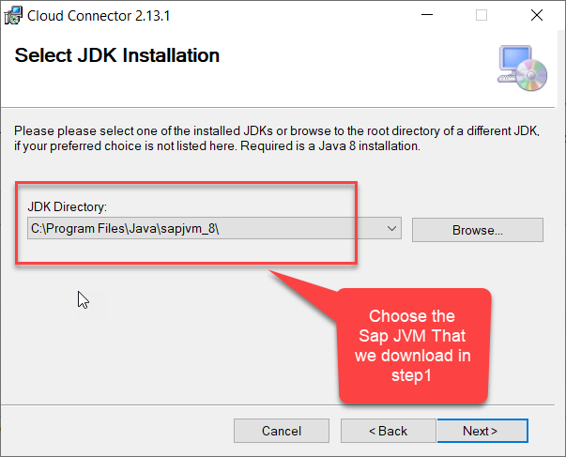
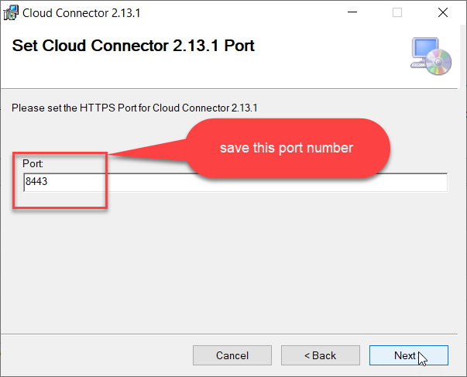
Cloud connector continue…
Step 2: Download and install the sap Cloud connector

Slide 6
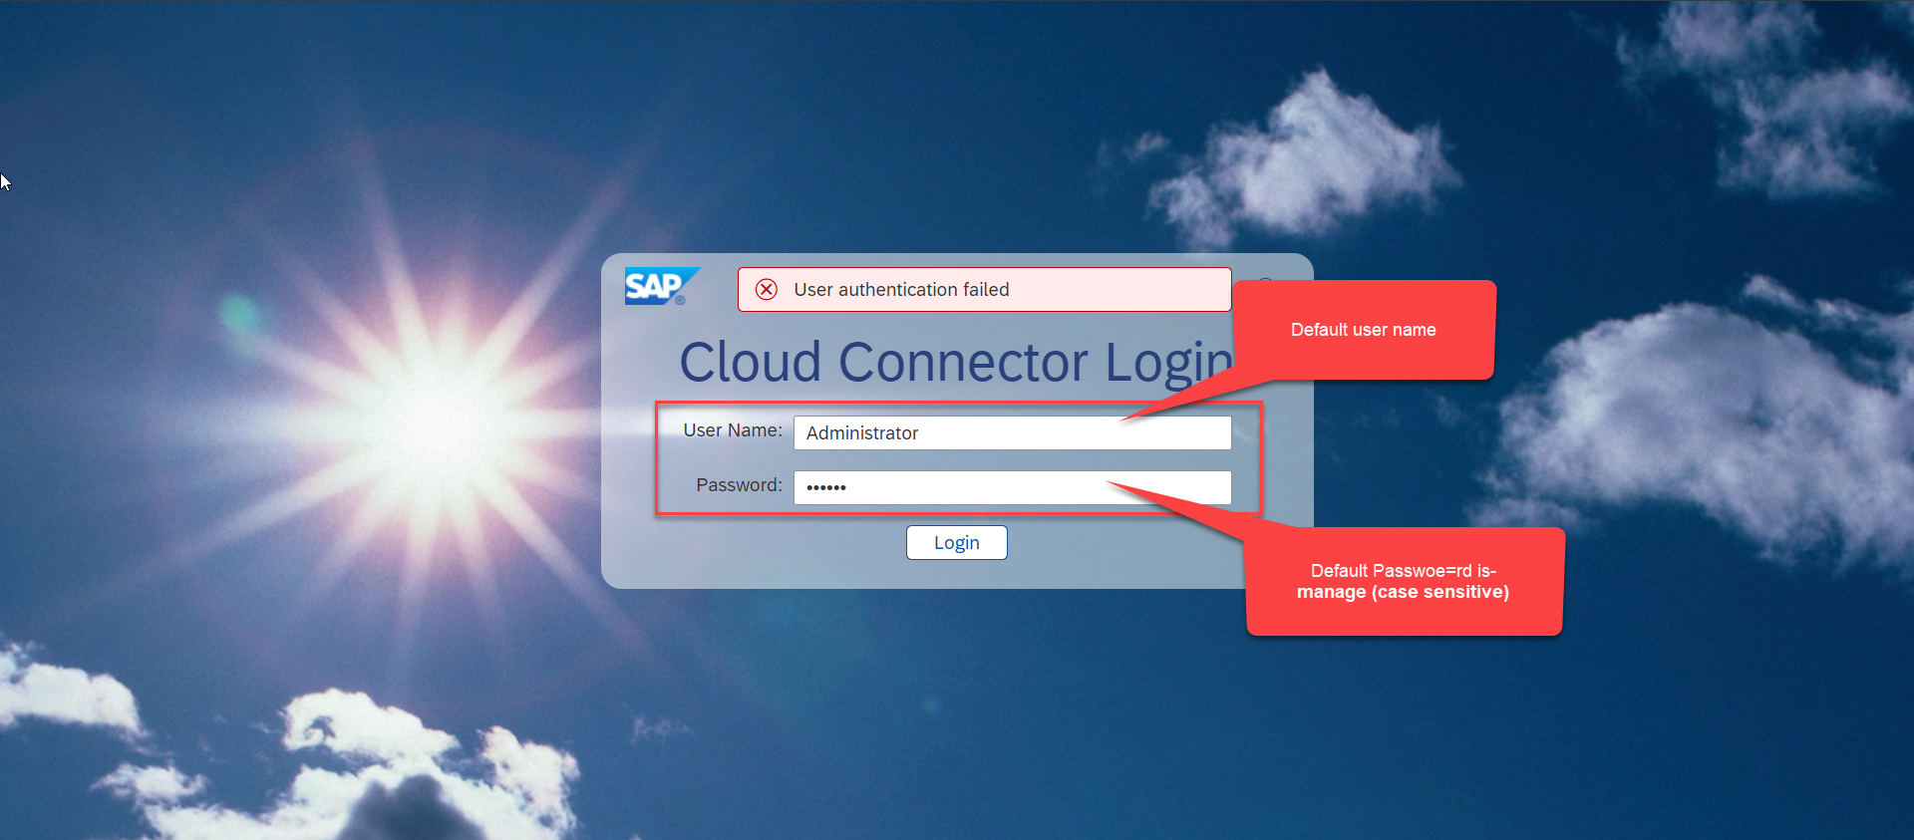
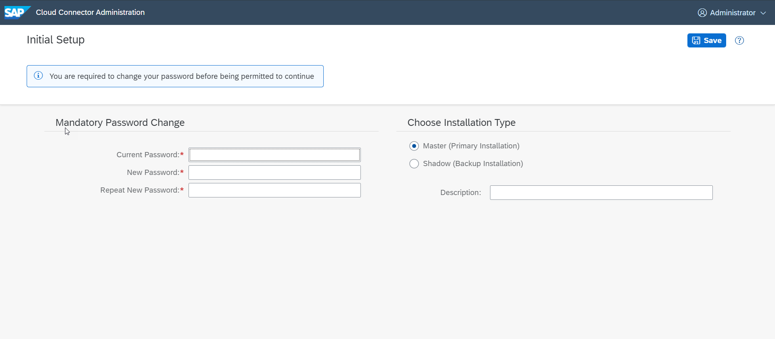
Cloud connector continue…
Step 3: Now your system is ready go to browser and open https://localhost:8443 (port may changes)
The default credentials are Administrator / manage

Slide 7
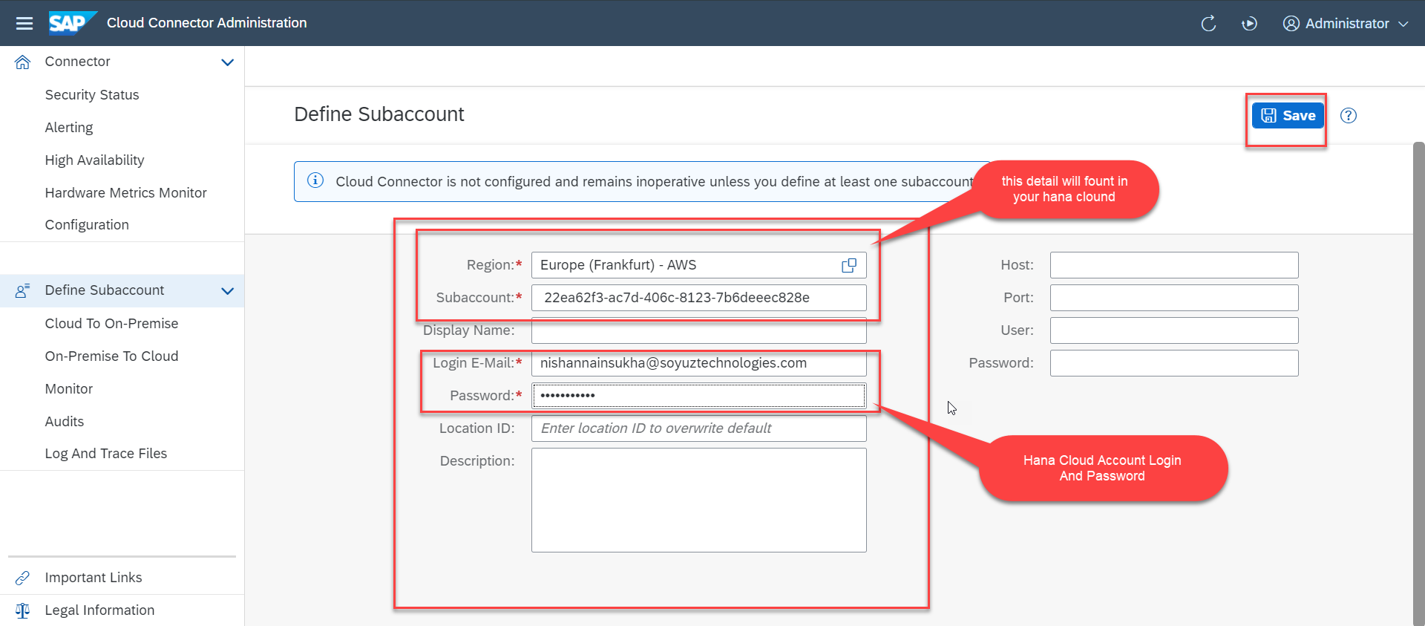
Cloud connector continue…
Step 4: Now we create a connection with our Cloud Account

Slide 8
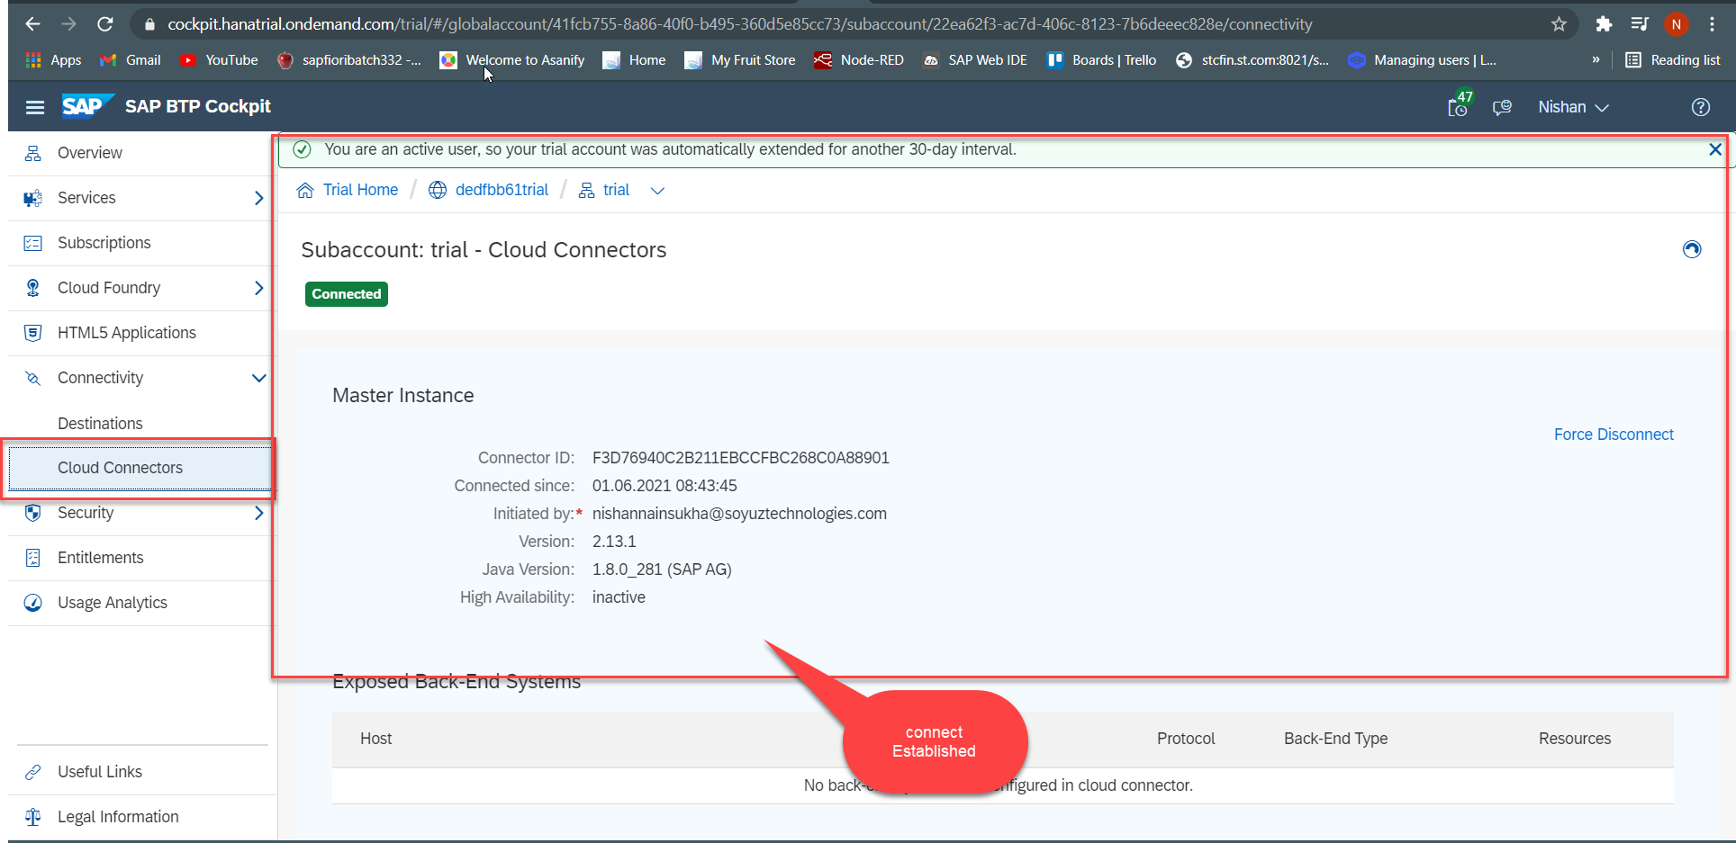
Cloud connector continue…
Step 5: Check the connection on Hana Cloud Account

Slide 9
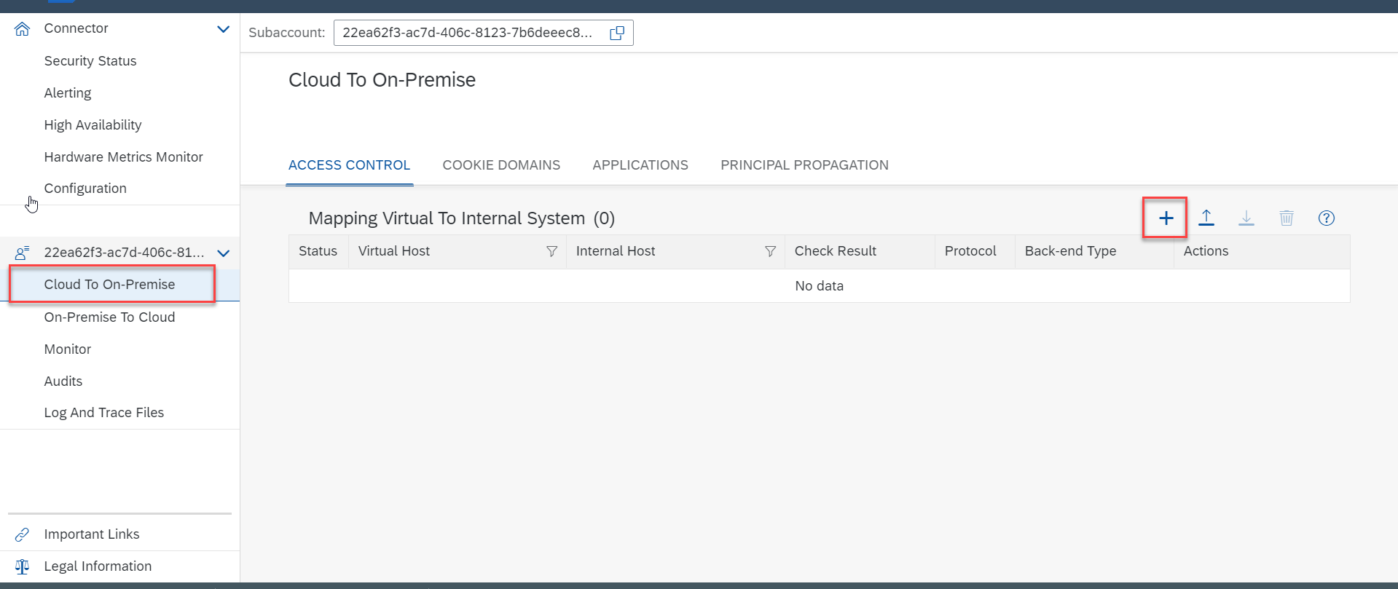
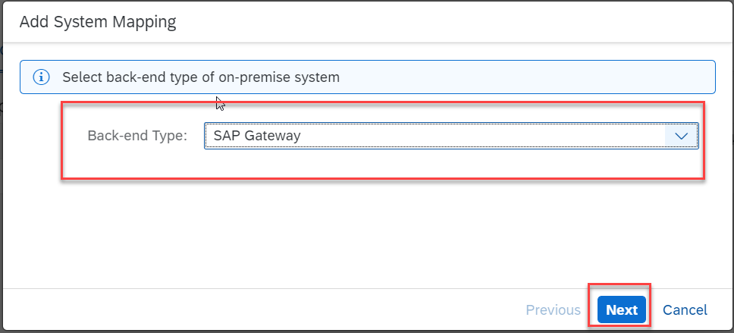
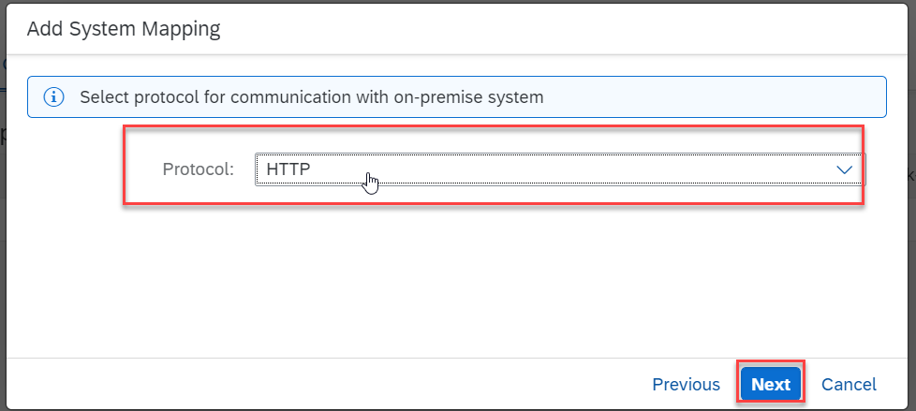
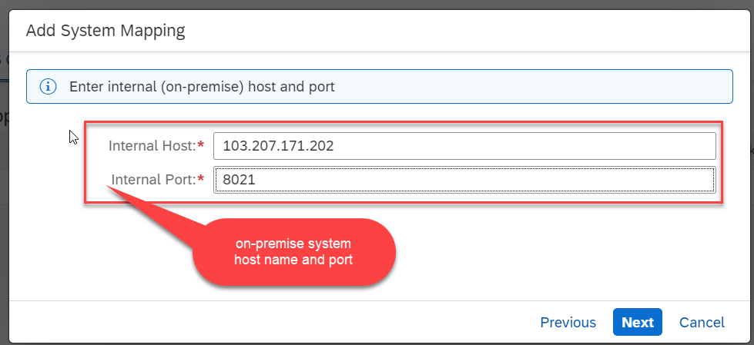
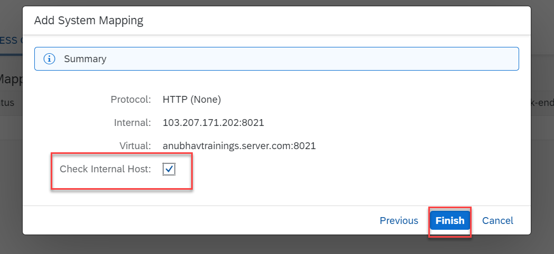
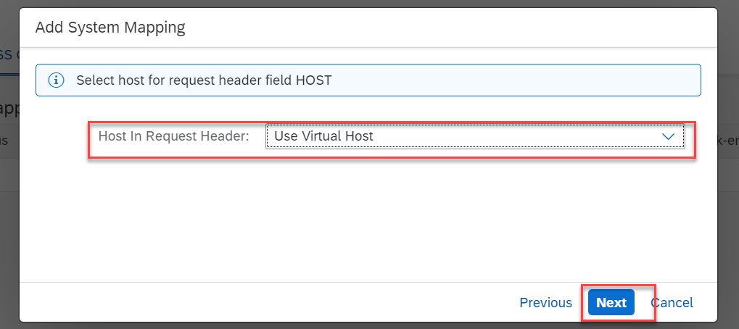
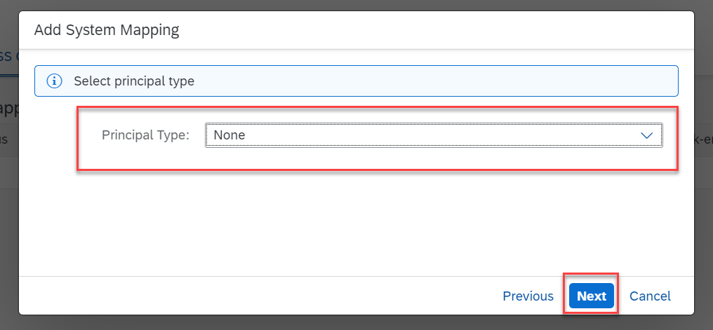
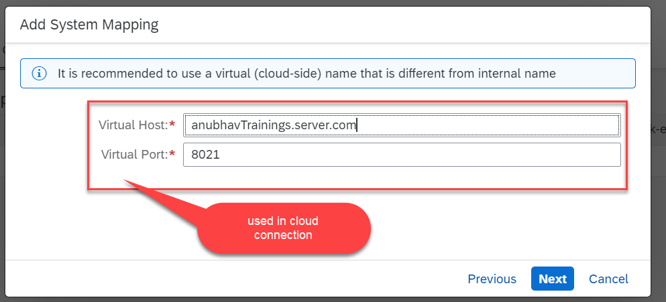
Cloud connector continue…
Step 6: Connect on-premise system to cloud using SCC

Slide 10
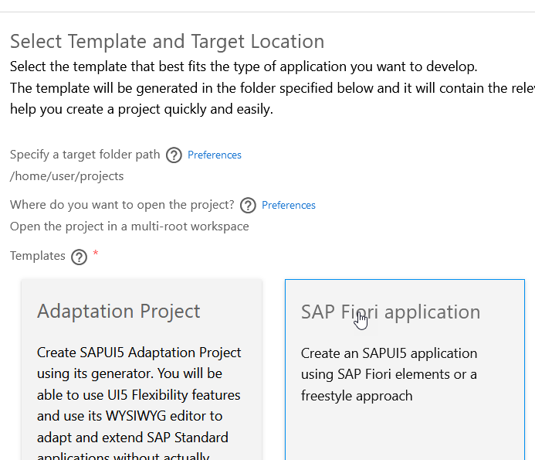
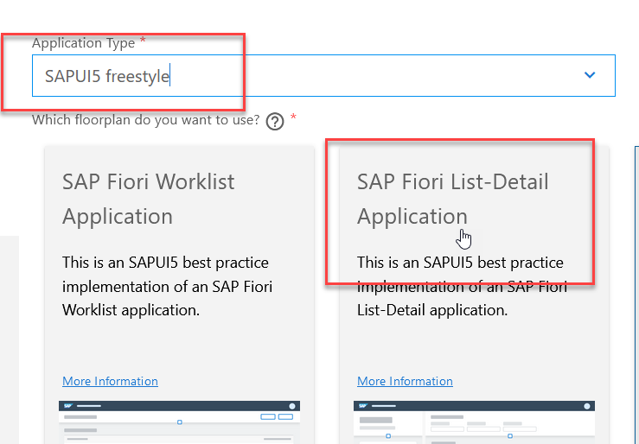
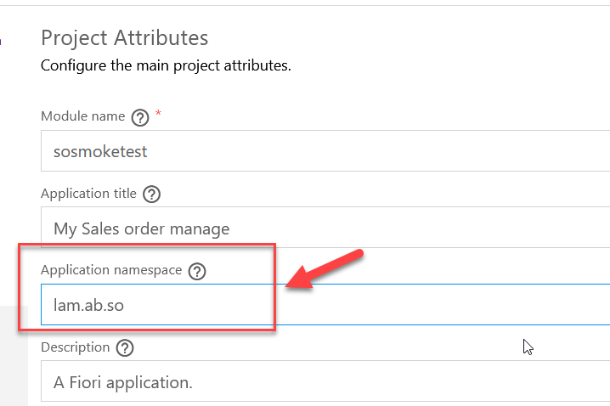
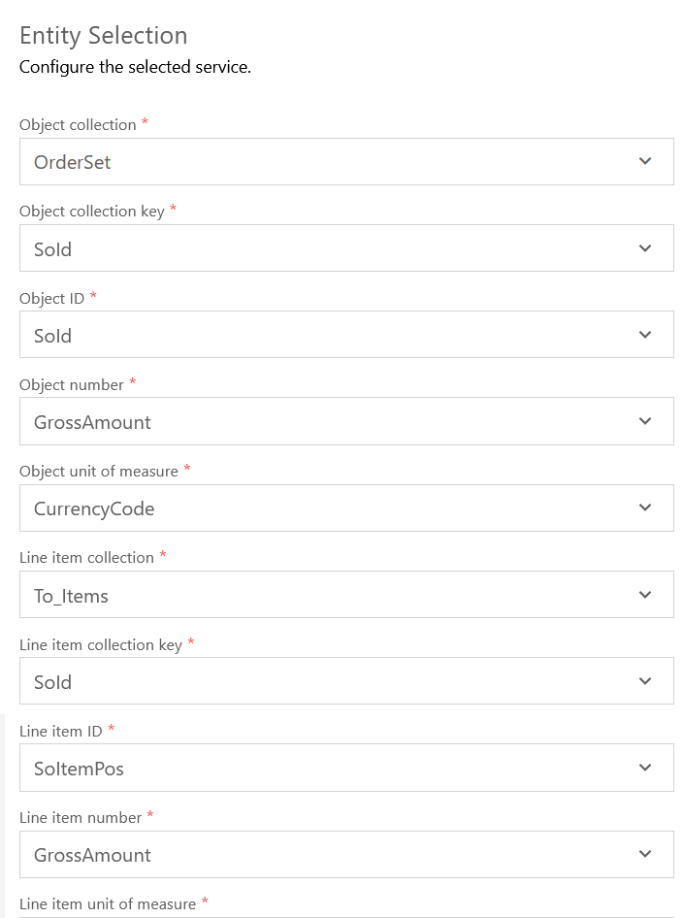
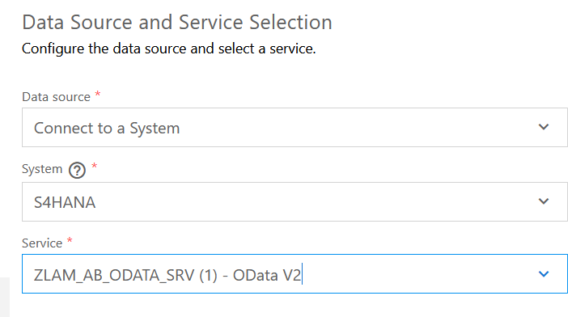

Slide 11
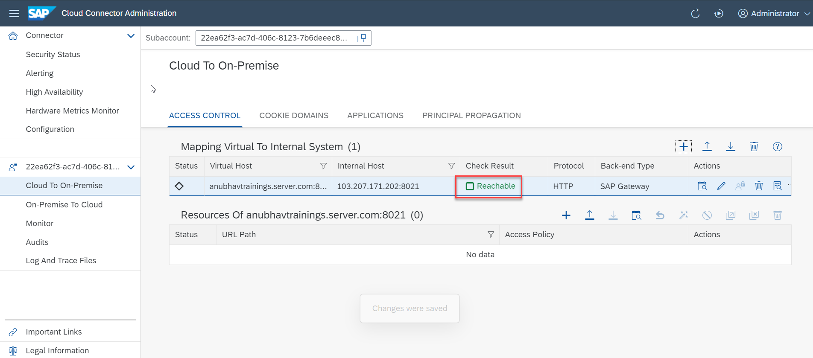
Cloud connector completed
We have Done with Connect , now we are now successfully connected to cloud using SCC.

Slide 12
CORS – Cross Origin Resource Sharing
It is a browser security policy which prevent us connecting to a domain while running web page on a different domain.
Browser
S
https://workspaces-ws-7qbs5-app3.eu10.trial.applicationstudio.cloud.sap/
Proxy
Facebook.com
Google.com
Another Server
http://103.207.181.202:8021/sap/opu/odata/sap/ZOCT_ODATA_SRV/$metadata
https://www.npmjs.com/package/@sap/ux-ui5-tooling

Slide 13
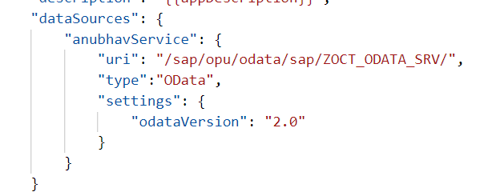
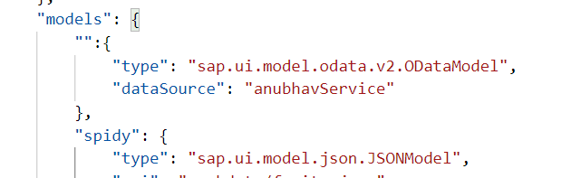
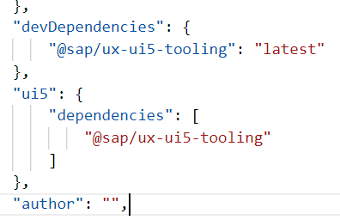
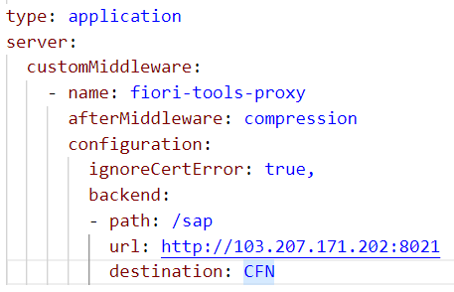
Integration of OData in our Fiori Project
Steps to Integrate our Fiori app with the OData service we have created.
Step 1: Go to manifest.json and define a data source in sap.app section.
Step 2: Go to sap.ui5 section and create a default data model for this data source
TO AVOID CORS issue in BAS tool so we can connect to our SAP SERVER
Step 3: Add a dev-dependency in package.json file to latest UI5 tooling - @sap/ux-ui5-tooling
Step 4: Also add a section called UI5 in package.json to use the tooling for the project.
Step 5: We will cheat the browser by adding a proxy module, this proxy module will re-direct all the calls starring /sap top our SAP Server via destination. In ui5.yaml file provide middleware configuration
Step 6: Test app using ui5 serve or fiori run command
Step 7: Binding with ODATA entityset

Slide 14
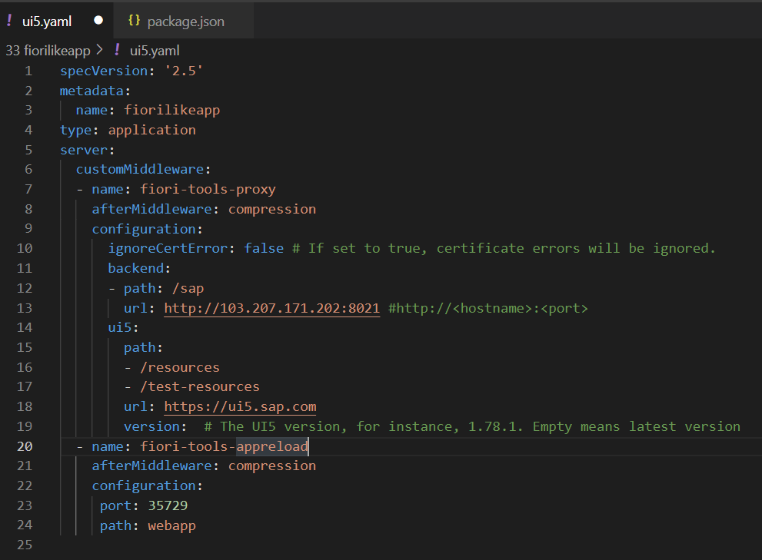
Configuring ui5.yaml for VS Code
To use the OData service in VS Code we must configure the ui5.yaml file according to that. We need to configure it according to the below format.
specVersion: '2.5'
metadata:
name: fiorilikeapp
type: application
server:
customMiddleware:
- name: fiori-tools-proxy
afterMiddleware: compression
configuration:
ignoreCertError: false
backend:
- path: /sap
url: http://<hostname>:<port>
ui5:
path:
- /resources
- /test-resources
url: https://ui5.sap.com
version:
- name: fiori-tools-appreload
afterMiddleware: compression
configuration:
port: 35729
path: webapp

Slide 15
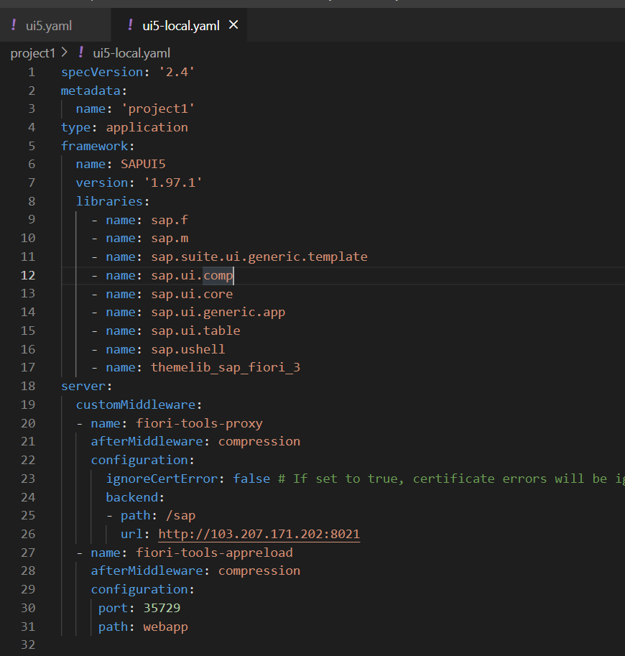
ui5-local.yaml configuration
To run and access the OData service in application in a local environment we also need a ui5-local.yaml file. The structure of ui5-local.yaml file is shown below:
specVersion: '2.4'
metadata:
name: 'project1'
type: application
framework:
name: SAPUI5
version: '1.97.1'
libraries:
- name: sap.f
- name: sap.m
- name: sap.suite.ui.generic.template
- name: sap.ui.comp
- name: sap.ui.core
- name: sap.ui.generic.app
- name: sap.ui.table
- name: sap.ushell
- name: themelib_sap_fiori_3
server:
customMiddleware:
- name: fiori-tools-proxy
afterMiddleware: compression
configuration:
ignoreCertError: false # If set to true, certificate errors will be ignored. E.g. self-signed certificates will be accepted
backend:
- path: /sap
url: http://103.207.181.202:8021
- name: fiori-tools-appreload
afterMiddleware: compression
configuration:
port: 35729
path: webapp

Slide 16

Exercise: Fiori Integration
In this exercise we will add the configuration to Integrate the OData with our existing app.
And we will bind the View1 with the OData model.
Along with that we will also see how to read the data of a single product.
To do that when we select a product form the product list then the details of that product will be loaded on the View2.
Exercise part 1 code/resource: Configuring the app to access OData and loading the list of products on view1
manifest.json
ui5.yaml
package.json
View1.view.xml
ui5.yaml and ui5-local.yaml config for VS Code
ui5.yaml
ui5-local.yaml
Exercise part 2 code/resource: Getting the data of single product with association To_Supplier on View2.
View1.view.xml
View1.controller.js
View2.view.xml
View2.controller.js
MoreInfo.fragment.xml

Slide 17

End of Day 18

Slide 18

Questions

Slide 19

Anubhav Oberoy

Slide 20


We’re committed to empower you to be
Most Desirable Resource
through powerful training solutions.
We build the workforce of the future.
250+
Corporate Clients
30,000+
Learners Trained
25000+
Learners Placed
FREE WEBINARS
Sign up for free webinars with industry experts every fortnight!
Enroll Now!
Contact us today!
https://anubhavtrainings.com/

Slide 21




More from AnubhavTrainings.com

Slide 22
Title
Content

